Slide 1
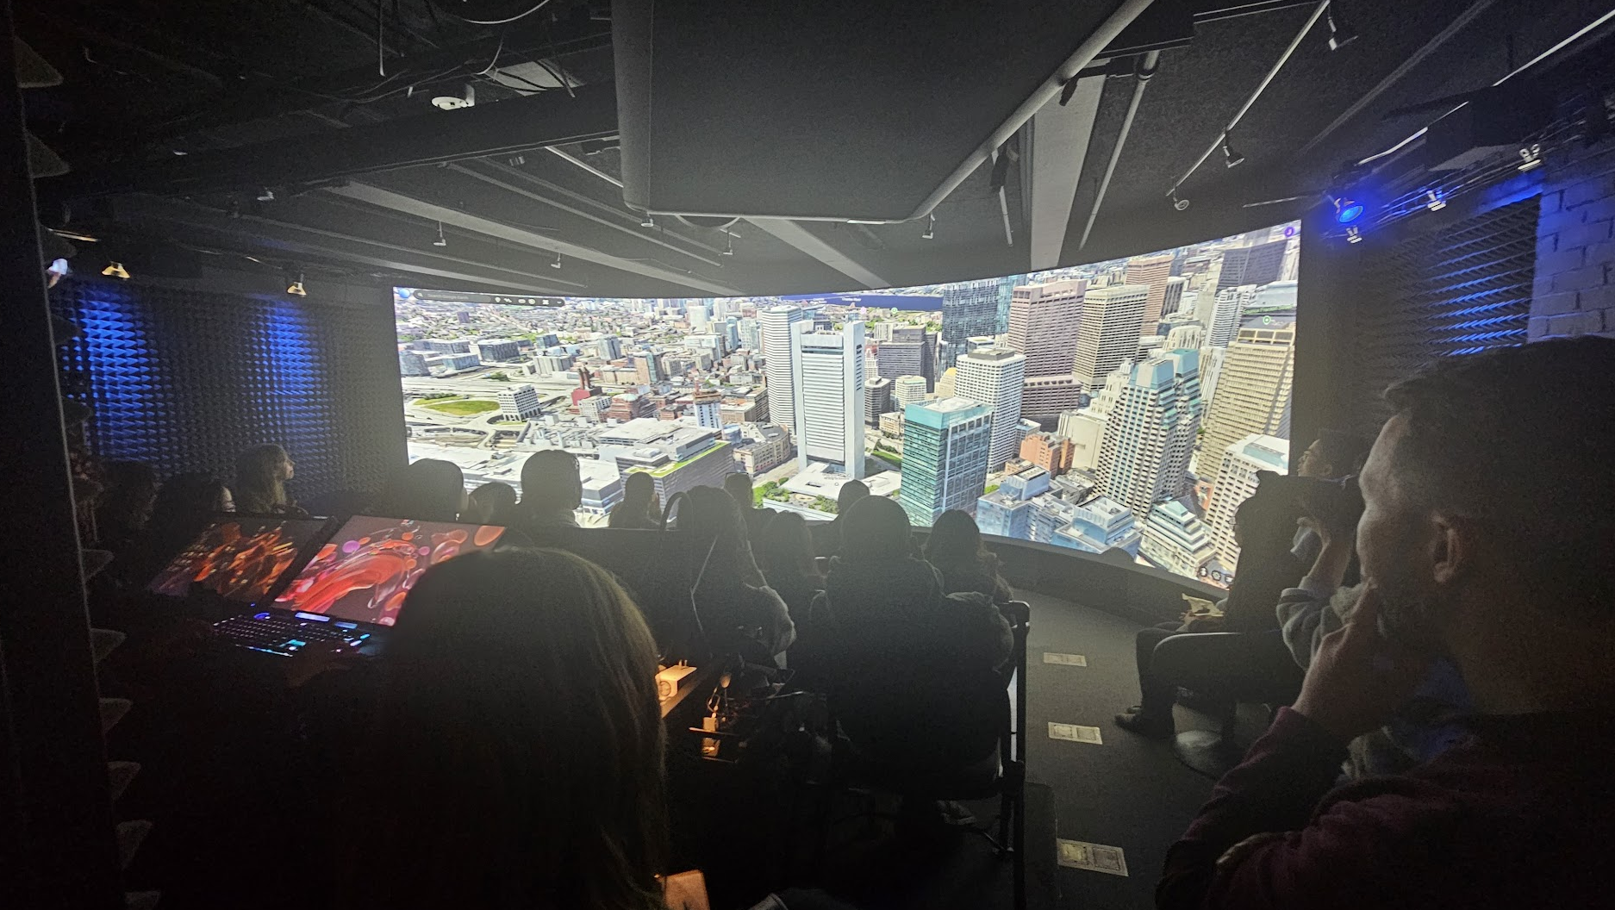
stephenguerin@fas.harvard.edu
Collaboration: 2025 GSD Core IV Studio – The Near-Future City

Slide 2
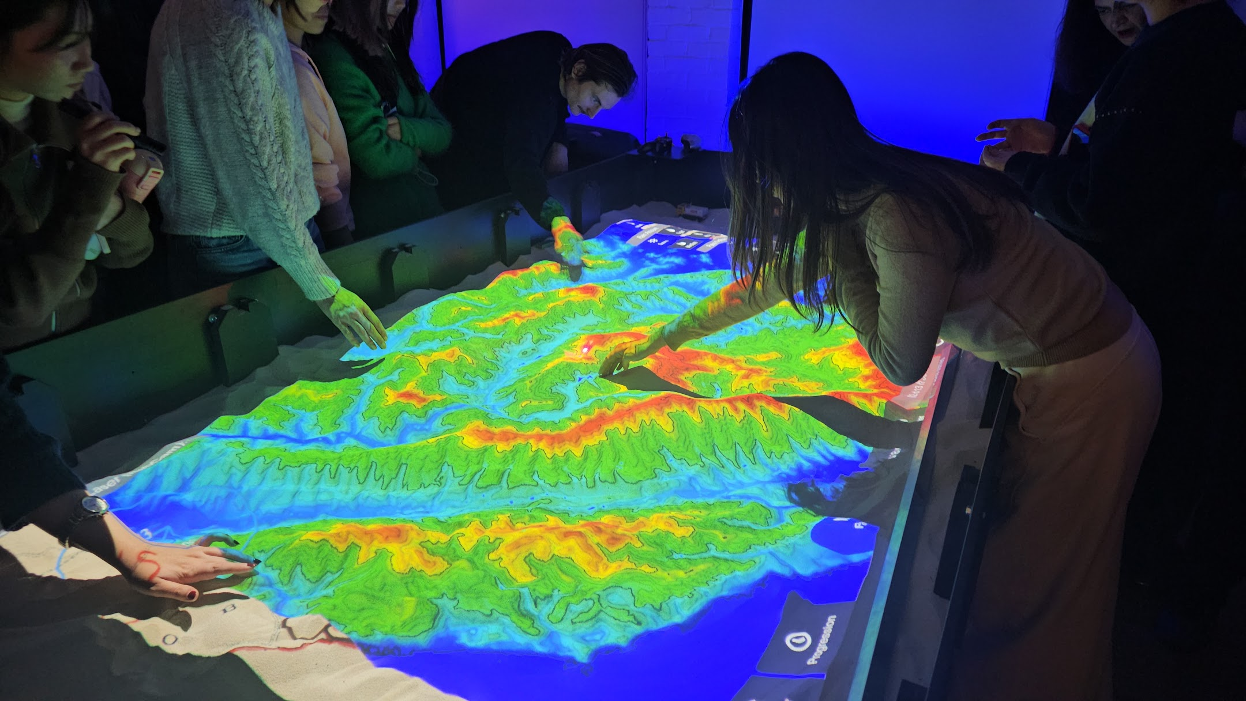

Slide 3
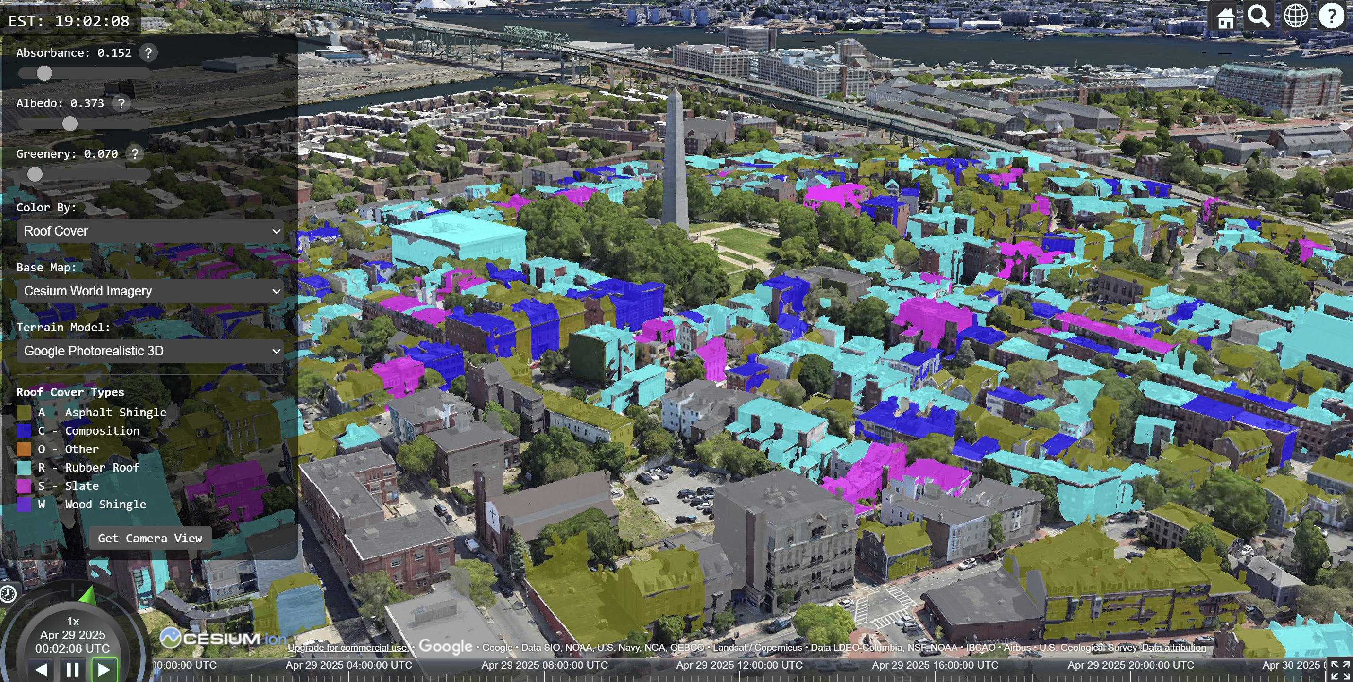
Urban Heat Island Mitigation – Roof Study with Alec Melko

Slide 4
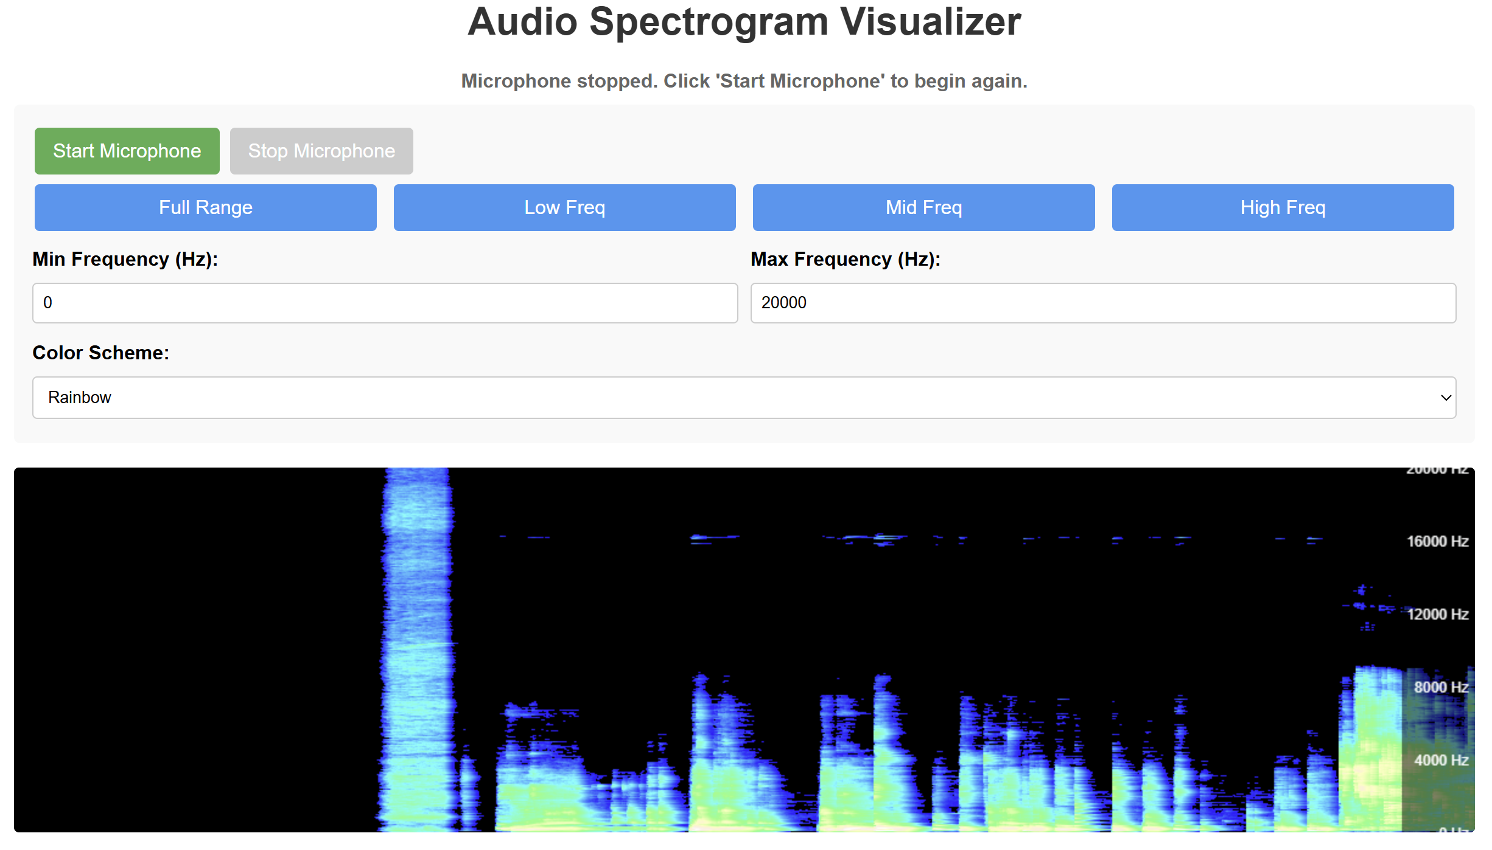
Sensing and Modeling Urban Acoustics with Zhang Yihan

Slide 5
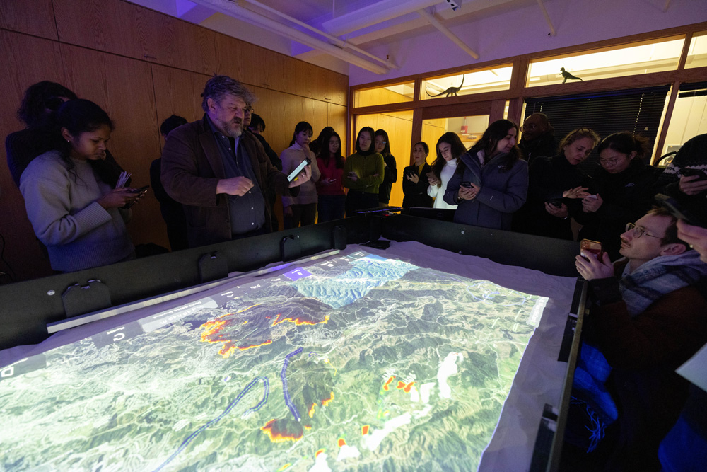
Visualizing 2025 Los Angeles Fires Palisades and Eaton

Slide 6
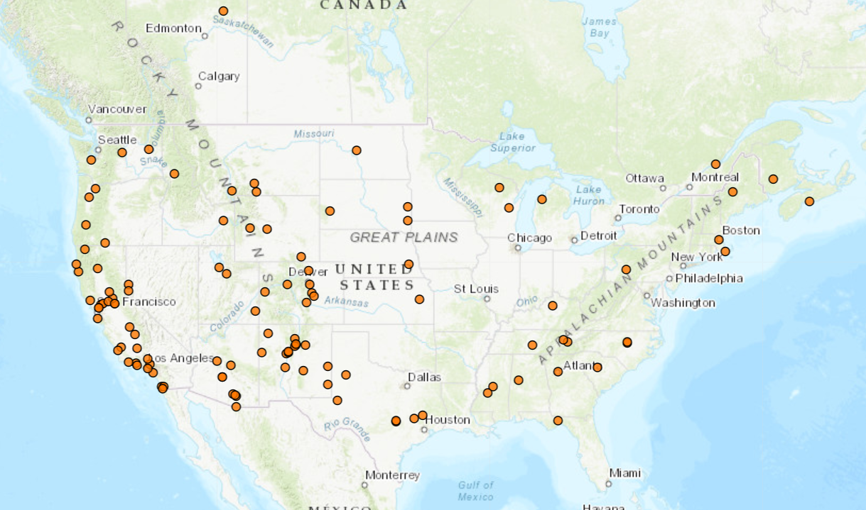
Community Resilience and Education with Simtables

Slide 7
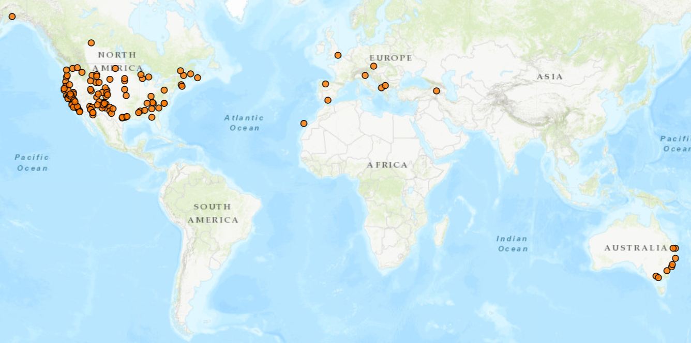
Community Resilience and Education with Simtables

Slide 9
stephenguerin@fas.harvard.edu
Collaboration: 2025 GSD Core IV Studio – The Near-Future City

